Slide 1

Class 3
Curriculum Evenings
Year 3
Curriculum Evening
2025-26

Slide 2



Curriculum Evenings
Overview
Year 3
PSHE
Computing
School Blog.
Maths.
Calculation strategies.
Home Learning (Maths).
English.
Handwriting.
Reading.
Spelling.
Homework.

Slide 3

Curriculum Evenings
PSHE at Cathedral School
PSHE
PSHE is central to the educational entitlement of all children at Cathedral School.
Every class has one PSHE lesson every week.
At Cathedral School, Years 1-6 are taught PSHE across three core themes:
  Health and Wellbeing
  Relationships
  Living in the Wider World

Slide 4
Curriculum Evenings
PSHE in Year 3
PSHE
Class 3 will learn about:
Physical health and well-being, including making informed decisions about what we eat, and the importance of keeping active.
Keeping safe and managing risk, including identifying bullying and how it can make us feel.
Mental health and emotional well-being, including celebrating our achievements; setting personal goals and positive ways to deal with setbacks.
Identity, society and equality, including valuing the similarities and differences between ourselves and others, and identifying some of the communities we belong to.
Keeping safe and managing risk, including learning where medicines come from and how they can sometimes be harmful.
Spending and budgeting money, including how people choose to spend their money, and the world of work.

Slide 5
Curriculum Evenings
Computing in Year 3
Computing
In computing, Class 3 will:
Learn how to use the internet in a safe and responsible way through Google
Develop their understanding of digital devices with a focus on inputs, processes and outputs
Learn a range of techniques to make a stop-motion animation
Learn digital literacy skills e.g. image and text editing
Develop their understanding of what a branching database is and how to create one
Be introduced to the basics of Scratch where they will create simple sequences
As we move into a more digital world, it is imperative that children are safe online. Information about how you can support your children at home can be found through the following link: https://www.internetmatters.org/resources/online-safety-guide-6-10-year-olds/

Slide 6
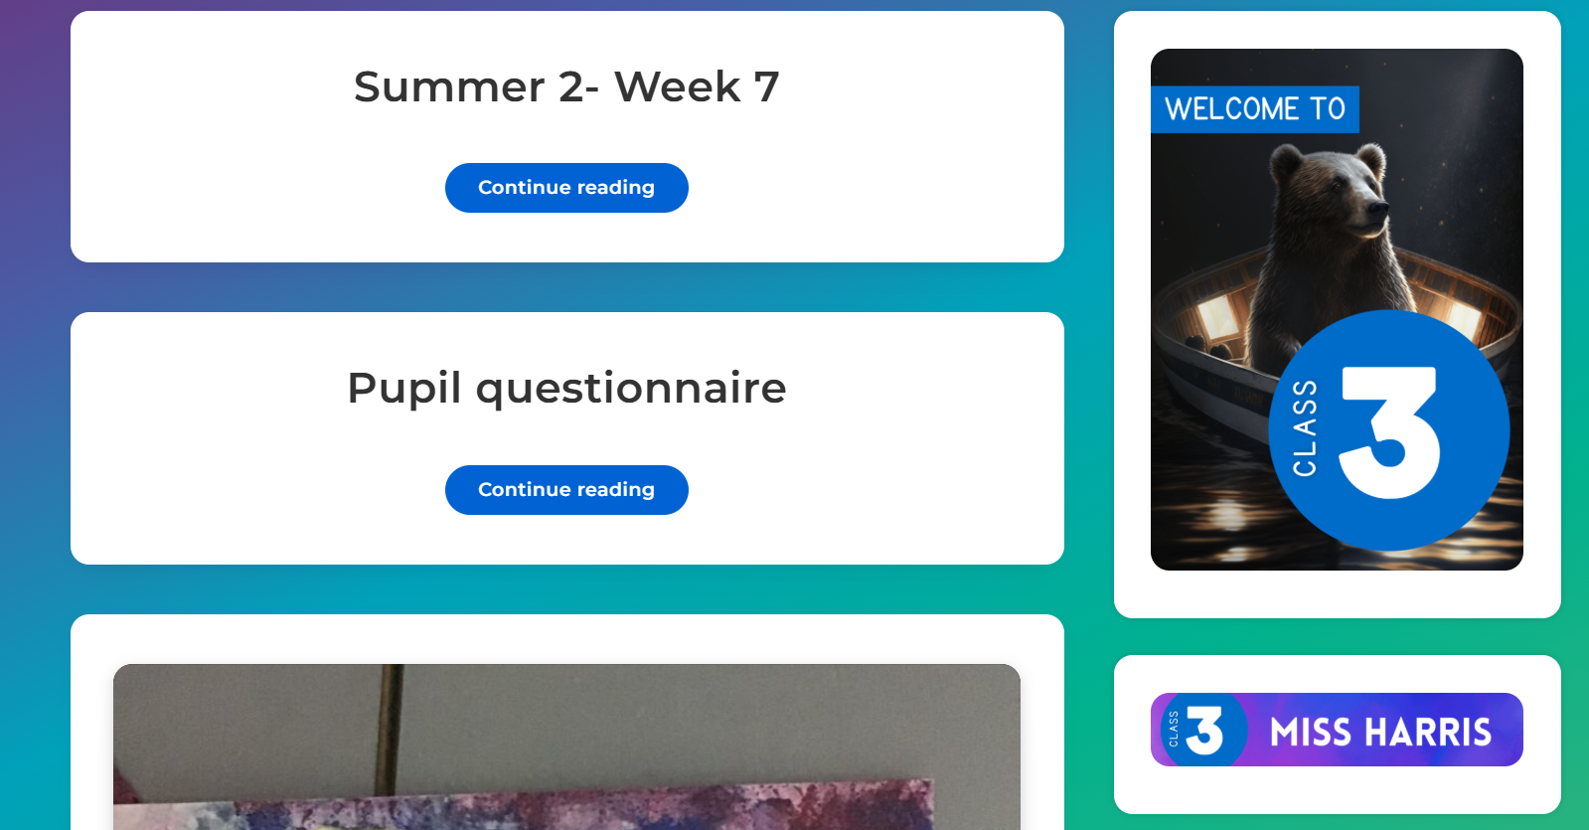
School Blog
Curriculum Evenings
Year 3
P.E and Uniform- Check the Cathedral School blog for all information regarding uniforms.
Label EVERYTHING please!
Objectives for Year 3, reading recommendations and termly curriculum overviews.
Our Class Blog!
https://thecathedralschool.co.uk/class3/
http://www.cathedralprimaryschool.com/wp-content/uploads/2018/06/Uniform-Policy.pdf

Slide 7

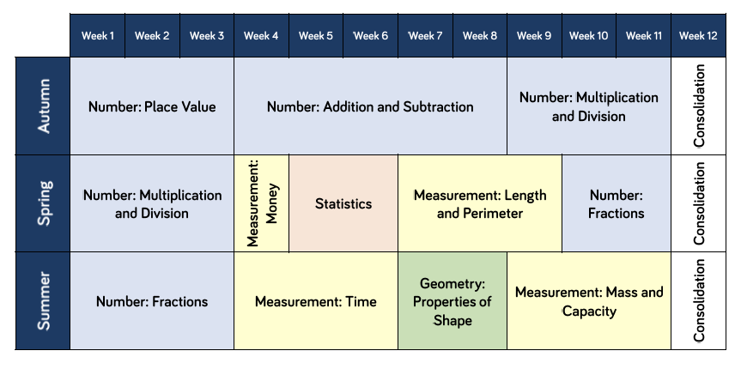
Curriculum Evenings
Maths
Year 3
In Class 3 we begin with a focus on ‘Number & Place Value’, then build on this knowledge to learn about the four operations and other areas of mathematics in the course of the year.
We use a range of strategies so children build up a deeper understanding of what is actually going on when ‘borrowing’, ‘carrying’, etc. as they begin to learn the formal methods.
Full details can be found on the website: http://www.cathedralprimaryschool.com/maths/calculations/

Slide 8
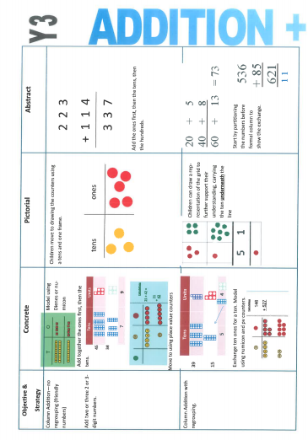

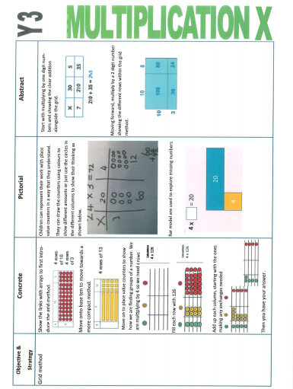
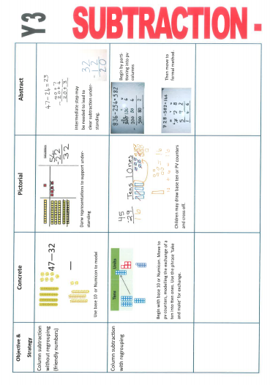
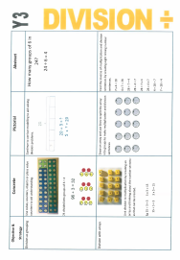
Curriculum Evenings
Calculation Strategies
Year 3

Slide 9

Curriculum Evenings
Home Learning in Maths
Year 3
What can you do at home to help them in Maths?
Number fluency
Times Tables:
Year 2- x2, x5, x10
Year 3- as above, and x4, x8
Your child will be given a login for Times Tables Rock Stars.
Addition facts within 20:
Adding any two 1-digit numbers together should be automatic as it allows for fluent work on more complex problems. Frequent practise at home and school is essential.
Other resources/ ideas
Topmarks- Free resource on the internet, including rapid recall games such as: http://www.topmarks.co.uk/maths-games/hit-the-button
Real life problems- opportunities to ask questions! For example:
Travelling: We have to get the train at 4pm and the journey is half an hour. When will we arrive?

Slide 10

English
Curriculum Evenings
Year 3
Where possible, we focus on a high-quality work of fiction to engage children in their writing.
Extended writing is now part of the weekly timetable and your child will be asked to write at length on a subject related to their current learning, or a stand-alone writing task.
Writing, reading, spelling and handwriting are all equally important components. Although taught as discrete subjects in the timetable, children in Class 3 will be encouraged to use these skills in ALL lessons.
Please make sure your child always has a spare handwriting pen at school. These can be purchased from the school office.

Slide 11

Handwriting
Curriculum Evenings
Year 3
Cripps style of writing. Includes no loops on the ‘y’, ‘j’ or ‘g’.
15 minute handwriting lessons are taught at least 3 times a week.
Handwriting is considered when looking at the attainment of your child in English.
Extra handwriting homework will be given to children who need more practise.
It is essential to form separate letters the right way around before joining, as this allows for fluent, legible cursive and greater ease when writing at length.
At the beginning of Class 3, pupils will need to demonstrate they can form individual letters correctly before showing that they know the correct joins. This will be the focus of taught handwriting sessions. Pupils will also be given the opportunity once a week to write at length in cursive if they feel ready.

Slide 12


Reading
Curriculum Evenings
Year 3
Reading with an adult in school encourages children to engage with a text and analyse different aspects of what they have read.
Your child will be given both fiction and non-fiction texts to read.
Your child will be responsible for handing in their reading folder once they have finished reading both of their books.
Comprehension skills complement and aid pupils’ writing.
What can you do at home?
Reading records must be signed by an adult at least three times a week. This must include the reading scheme books, as well as other books that your child wishes to read.
It is important to let children read for pleasure as well, so do allow them this time.
‘VIPERS’ questions in reading records you can ask when reading with your child.
  Ask them WHY?

Slide 13
Spelling
Curriculum Evenings
Year 3
Weekly spellings will be set. Pupils have one week to memorise their spellings.
Spelling homework task: Spelling sentences are to be written for each spelling word, in the ‘Notes & Drafts’ book. This helps to ensure that your child understands the meaning of the word and can put it into the correct context.
For example:
Address.
Neatly, I wrote the address on the postcard so that it was ready to be put in the post-box.
This is also an opportunity for the pupils to practise their handwriting and punctuation at home.

Slide 14

Homework
Curriculum Evenings
Year 3
Homework will be set Monday to Thursday.
Your child will have approximately 20-30 minutes homework to do every evening. Please allow time for this.
The purpose of homework is to consolidate learning from class. Children should be able to work independently on each task set.
An average weekly homework timetable in year 3:
Monday- SPAG (spelling, punctuation and grammar)
Tuesday - piece of homework related to learning in school
Wednesday - Times tables rockstars
Thursday -Weekly spellings to learn and use in sentences for spelling test
Handwriting sheets will be given to pupils who require extra practice

